Slide 1




Crime & Socioeconomics in North Carolina Counties
Group Presentation

Slide 2

Project Members
Jagadeesh Ramasetty - JXR210028
Sudheer Babu Nalamothu - SXN220105
Bhargava Venkat Lukka - BXL210005
Kattunga Madhurika - MXK210054
Pendyala Narendranath Chowdary - NXP210038

Slide 3


INTRODUCTION
In criminology and public policy, crime rates and the factors that influence them are crucial subjects. Policymakers can improve public safety by making well-informed decisions if they are aware of the factors that affect crime rates. This research intends to analyze crime rates in North Carolina counties and investigate the associations between these rates and various socioeconomic characteristics.
Objectives
To investigate how crime rates differ amongst North Carolina counties.
To determine and quantify the effect of socioeconomic factors on crime rates.
To determine how well law enforcement factors (such as police per capita and the likelihood of an arrest) contribute to a decline in crime.
To help policymakers solve issues related to crime in various counties by offering insights and suggestions.

Slide 4
Methodology
Analyze crime rates using regression to measure the effect of factors like population density, income levels, police presence, and other pertinent aspects.
To determine the effects of independent variables (such as population density, income, and police presence) on the dependent variable (crime rates), perform a multiple regression analysis. For a better fit, think about utilizing log-transformed variables.
Give specific county-specific policy recommendations based on your study. Think about the particular traits and difficulties that each county faces.
Create reports or presentations that are clear and simple for policymakers, stakeholders, or the general public.
Consider employing cutting-edge techniques like instrumental variable analysis or propensity score matching to estimate the causal impact of particular policies or interventions on crime rates if your research's goals require determining causality.

Slide 5

Expected Outcomes
A detailed investigation into the causes of the factors influencing crime in the counties of North Carolina.
To address issues related to crime, particular counties-specific policy recommendations are made.
Identification of key factors influencing crime rates, including the role of law enforcement.

Slide 6
Analysis
In accordance with our specific project requirements and dataset, we have conducted a comprehensive analysis employing a variety of methodologies and visual representations. This report will present an exposition of these analyses, featuring various plots and charts. Additionally, we will provide insightful interpretations and observations derived from these methodologies, contributing to a more profound understanding of our findings.

Slide 7
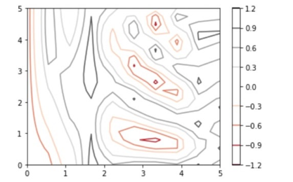
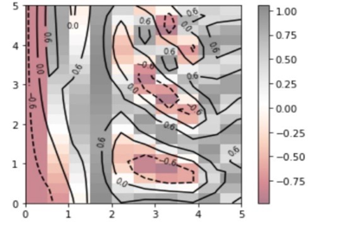
1) Contour Plot
The crime rate, or crmrte variable, is represented by the X-axis.
The chance of an arrest, or the prbarr variable, is represented by the Y-axis.
Plot contours are the lines connecting points with the same Z value.The function f is used to determine the Z value (x, y).
The color gradient, as displayed by the color bar, represents the spectrum of Z values. Darker tones denote higher values whereas lighter shades denote lower values.
Every contour line corresponds to a certain Z value. For example, the derived value of every point on a given contour line is the same.
The rate of change is shown by the distance between contour lines. Closely spaced lines indicate that the computed value changes quickly relative to slight variations in the crime rate or arrest likelihood.
Policymakers and analysts can better understand how changes in the arrest probability and crime rate may affect other parameters (represented by the derived Z values) by using the contour plot.

Slide 8
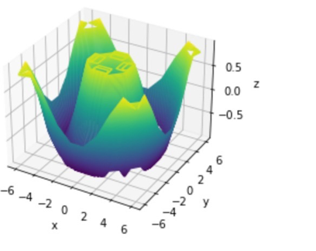
2) 3-Dimensional Plot
·The link between the probability of arrest (prbarr), the crime rate (crmrte), and their interaction is represented graphically in the plot.
·Areas where the probability of an arrest and the crime rate together have a particular effect on other socioeconomic or law enforcement elements may be indicated by regions with discernible patterns on the Z-axis.
·The contour lines and color gradients shed light on how this interaction is distributed and densely populated in various areas.
·Based on the observed trends, the graphic can be used to indicate regions that could need interventions or policy changes.

Slide 9
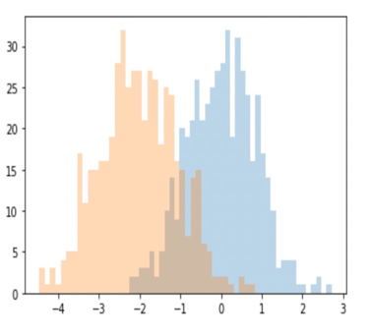
3) Histogram
·A graphical depiction of a dataset's distribution is called a histogram. It separates the data into bins, and each bin's height indicates how frequently data points fall inside its range.
·The histogram is generated using two features: crmrte (crime rate) and prbconv (probability of conviction).
·The histogram uses 40 bins, which means the data range is divided into 40 intervals, and the frequency of data points within each interval is represented by the height of the corresponding bar.
·Peaks in the histogram indicate ranges where many counties have similar crime rates, while valleys or gaps represent ranges with fewer counties.
·Overlapping regions can indicate counties where both the crime rate and the probability of conviction fall within specific ranges.
·Analyzing these overlaps can provide insights into the relationship between crime rates and conviction probabilities.
·The spread and shape of the histogram can provide insights into the variability and central tendency of crime rates.
·By examining the shape, spread, peaks, and overlaps of the histogram, one can derive valuable insights into the patterns and trends in crime statistics and the justice system's efficiency.

Slide 10
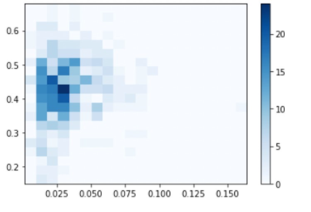
4) 2-Dimensional Histogram
A two-dimensional histogram can represent the joint distribution of two variables, unlike a 1-dimensional histogram. The 2D histogram can visually show the link between two variables, such as crimes committed per person and the probability of being sentenced to jail. The upper right corner may represent areas with high crime rates and high odds of going to jail, while the lower right corner may represent areas with high crime rates but low likelihood of imprisonment. The upper left corner may represent areas with low crime rates but strict judicial systems, and the lower left corner may represent peaceful areas with forgiving legal systems.

Slide 11
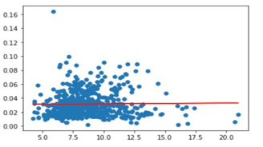
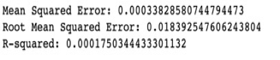
5) Linear Regression
Linear regression is a statistical method used to model and analyze the relationships between a dependent variable and one or more independent variables. The main goal is to find the best fit straight line that accurately predict the output values within a range.
A lower MSE indicates that the model fits the data better, while a higher MSE suggests a poorer fit. It's a key metric to evaluate the performance of a regression model Interpretation:
Regression 1-
Dependent Variable (Y): crmrte (Crime rate - crimes committed per person)
Independent Variable (X): avgsen (Average sentence in days)
The regression aims to understand how the average sentence duration impacts the crime rate.
MSE: Mean Squared Error measures the average squared difference between the actual and predicted values. A lower MSE indicates a better fit of the model to the data.
For Regression 1, the MSE value provides insights into how well the model predicts the crime rate based on the average sentence duration

Slide 12
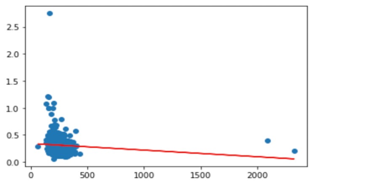
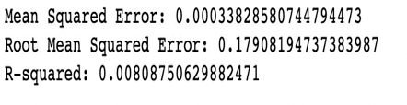
Regression 2-
Dependent Variable (Y1): prbarr (Probability of arrest)
Independent Variable (X1): wcon (Weekly wage in construction)
This regression explores the relationship between the weekly wage in the construction sector and the probability of arrest.
Visualization: The scatter plot showcases actual data points, with the red line representing the predicted values from the regression.
MSE: As with the first regression, the MSE for this regression measures the average squared difference between the actual and predicted values. A lower value indicates a better fit.
For Regression 2, the MSE value indicates the accuracy of the model in predicting the probability of arrest based on the weekly wage in construction.

Slide 13
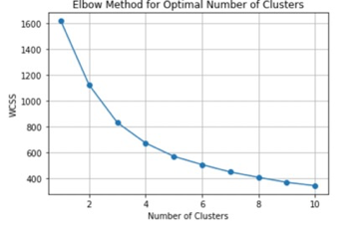
6) Elbow Method for Optimal no of clusters
When using clustering algorithms, particularly K-means clustering, the elbow approach is a useful tool to figure out the ideal number of clusters. charting the within-cluster sum of squares (WCSS) versus the number of clusters is the method's charting technique. The ideal number of clusters is indicated by the point at which the decline in WCSS starts to level out, forming an "elbow".
X-axis: Represents the number of clusters.
Y-axis: Represents the WCSS, which is a measure of the total variance within the clusters. Lower WCSS values indicate that the data points are closer to the centroids of their respective clusters.
The WCSS tends to decrease as the number of clusters rises.
An "elbow" is formed on the graph at a specific point where the rate of drop changes drastically.
The ideal number of clusters is thought to be the one at which this shift is observable.
The ideal number of clusters for the crime and socioeconomic data in the cornwell.dta dataset can shed light on associations between counties with comparable traits.
Using these clusters, policymakers can carry out focused interventions that are tailored to the particular difficulties and traits of each cluster.

Slide 14
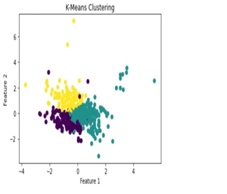
7) K- Means Clustering
K-means clustering is an unsupervised machine learning technique used to partition data into distinct groups based on their similarities.
The scatter plot visualizes the results of the K-means clustering.
X-axis: Represents 'Feature 1' from the dataset.
Y-axis: Represents 'Feature 2' from the dataset.
Data Points: Each point on the scatter plot represents a data entry from the cornwell.dta dataset.
Data points are color-coded based on their cluster assignments. Each color represents a distinct cluster.
Clusters: The different colors on the scatter plot represent distinct clusters. Data points within the same cluster share certain similarities, making them more alike to each other than to those in other clusters.
Distribution: The spatial distribution of the clusters can provide insights into the underlying patterns in the data. For instance, tightly packed clusters may indicate regions with high data density and strong similarities, while sparse clusters might suggest variability.
Centroids: Although not explicitly shown, K-means clustering also determines cluster centroids, which are the mean of all the data points in a cluster. These centroids can be used to understand the central tendencies of each cluster.
In conclusion, The K-means clustering scatter plot provides a visual representation of how counties (or data points) from the cornwell.dta dataset are grouped based on their inherent similarities in crime statistics and socio-economic indicators. By examining the distribution and grouping of these clusters, one can derive insights into potential patterns, trends, or anomalies in the data.

Slide 15
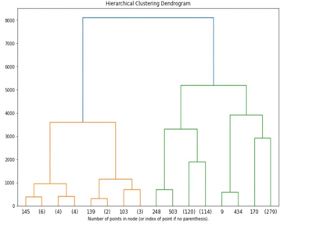
8) Hierarchical Clustering Dendogram
A dendrogram is a tree-like diagram used in hierarchical clustering to illustrate the arrangement of clusters. Each branch represents a cluster of data points, and the height at which two branches merge represents the distance (or dissimilarity) between those clusters.
The dendrogram was generated using the Agglomerative Clustering method from the sklearn.cluster module. The entire dataset was used for clustering, and the dendrogram illustrates the hierarchical structure of these clusters.
Branches: Each branch in the dendrogram represents a cluster of counties. The length of the branches indicates the distance (or dissimilarity) between clusters.
Merging Height: The height at which two branches merge represents the similarity between those clusters. The lower the merging point, the more similar the clusters are.
Truncation: The dendrogram is truncated at a certain level (p=3), which means only the last three merged clusters are shown. This helps in simplifying the visualization.
Counties that merge at lower heights are more similar in terms of their crime statistics and socio-economic indicators.
The longer branches indicate clusters that are quite distinct from others.
The structure of the dendrogram can help identify groups of counties with similar challenges or characteristics.

Slide 16
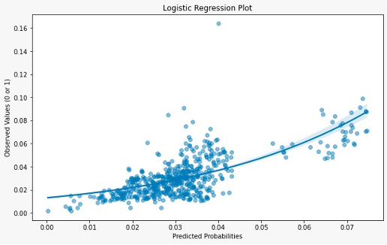
9) Logistic Regression
The logistic regression output will be a graph that showcases the relationship between predicted probabilities and observed binary outcomes (either 0 or 1).
Each point on the graph represents an observation, with the x-coordinate representing predicted probability and the y-coordinate depicting the actual observed binary outcome.
The logistic regression line is used to illustrate the estimated association between predictors and the binary response. Additionally, the alpha transparency of the points is set to 0.5 to enhance visualization.

Slide 17
Model Fit and Data Distribution:
By analyzing the fitted line in the graph, we can deduce an upward trend, which indicates that as the predicted probability of a crime occurring increases, the proportion of actual observed crimes also rises.
However, the majority of the data points tend to cluster at the lower end of predicted probabilities, suggesting that the model predicts a low probability of crime for most observations.
Statistical Analysis Implications:
This graph is employed to evaluate the logistic regression model's calibration, making it useful for diagnostic purposes.
A perfectly calibrated model would have predicted probabilities matching observed values along the 45-degree line.
If the points and the fitted line are positioned close to the 45-degree line, it suggests good calibration; if not, the model may require some adjustments.
Overall, this graph serves as a visualization tool to assess how effectively the logistic regression model predicts the occurrence of crime (or another binary outcome) across different probabilities, using the described dataset.

Slide 18
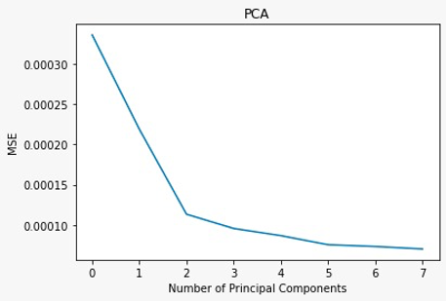
10) PCA Regression
• The output of the code is a plot showing how the mean squared error (MSE) changes as the number of principal components used in the linear regression model increases.
• The plot helps in identifying the optimal number of principal components that provides a good balance between model complexity and performance.
• This analysis is useful for understanding the trade-off between model complexity and predictive performance when using PCA for dimensionality reduction in linear regression.

Slide 19
Output:
• The MSE drops sharply as the number of principal components increases from 1 to 2.
• This indicates that the first two principal components account for a significant amount of variance in the predictor data and therefore provide substantial information for the prediction model.
• There is an 'elbow' around the third principal component on the graph.
• This point is significant because it often indicates the number of components to keep to have a parsimonious model.
• Beyond this elbow point, the reduction in MSE slows down, suggesting that additional components do not contribute as much to decreasing the error.
• After the third principal component, the MSE decreases at a much slower rate.
• This flattening of the curve implies that the additional variance explained by the subsequent principal components is minimal, and they may not contribute significantly to the model.
• It includes more components than necessary can lead to overfitting, where the model starts to capture noise rather than underlying data patterns.
• Conversely, using too few components can lead to underfitting, where the model fails to capture the complexity of the data and is unable to make accurate predictions.

Slide 20
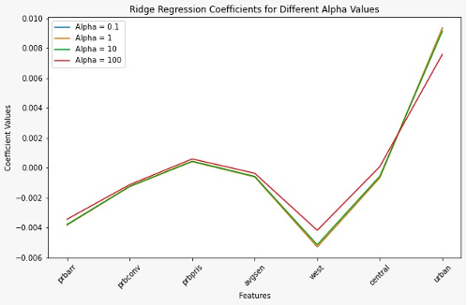
11) Ridge Regression
Ridge regression is a regularization technique used to prevent overfitting in linear regression models. It introduces a penalty term (L2 regularization) that adds a multiple of the square of the coefficients to the loss function. The hyperparameter alpha controls the strength of the regularization, and larger values of alpha lead to more regularization. Ridge regression is particularly useful when there is multicollinearity among the predictor variables. The output plot helps understand how the coefficients change for different regularization strengths (alpha values).

Slide 21
Output
• The output is a plot with multiple lines, each representing the coefficients of the features for a specific alpha value in Ridge regression.
• A larger alpha imposes stronger regularization, encouraging smaller coefficients and potentially preventing overfitting.
• RIDGE - The lines represent different alpha values, which are 0.1, 1, 10, and 100. These values dictate the strength of the regularization penalty. A larger alpha imposes a higher penalty, which results in greater coefficient shrinkage.
• Alpha = 0.1 is the smallest regularization strength shown and will therefore have the least amount of shrinkage effect on the coefficients.
• Alpha = 100 has the highest regularization strength among those shown, resulting in the most significant shrinkage of the coefficients.
• The y-axis shows the magnitude of the coefficients for different predictors (features) in the model. Positive values indicate a positive correlation with the dependent variable, and negative values indicate a negative correlation.
• The paths of the coefficients as alpha changes show how sensitive each feature is to regularization.
• Some coefficients may shrink faster than others as alpha increases, which can be due to the scale of the features, their correlation with the target variable, or their collinearity with other features.

Slide 22
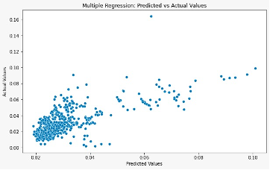
12) Multiple Regression Analysis
Multiple regression is a statistical technique used to model the relationship between a dependent variable and multiple independent variables. In this example, 'polpc', 'density', and 'taxpc' are the independent variables, and 'crmrte' is the dependent variable. The model estimates coefficients for each independent variable, allowing for the prediction of the dependent variable based on the values of the predictors. Multiple regression is commonly used for understanding the influence of several variables on an outcome and making predictions in a multivariate context.
Output:
• The output is a scatter plot that shows the relationship between the predicted values and the actual values from the multiple regression model.
• Ideally, the points should cluster around a diagonal line, indicating a strong relationship between predicted and actual values.
• The plot helps in visually assessing the model's predictive performance.
MULTIPLE - Outliers and Leverage Points:
• There are several points that stand out from the main cloud, especially at higher actual values.
• These outliers could disproportionately influence the regression model and skew the results.
• If these points have high leverage, they can pull the regression line toward themselves, which may distort the relationship between the independent and dependent variables.

Slide 23
Model Complexity:
• The model may be too simple to capture all the dynamics in the data, suggesting that additional variables or more complex relationships (such as polynomial terms or interaction effects) might need to be included.
Fit Quality:
• There's no visible diagonal line of perfect prediction, which means that while the model may be providing some level of prediction, it's not accurate across all values.
• Statistical measures such as R-squared, adjusted R-squared, and the F-test should be checked to evaluate the overall fit quality.
• To improve the model, one would consider exploring the data further, checking for missing variables, adding complexity to the model, or using different types of regression analysis better suited to the data's characteristics.
Fit Quality:
·There's no visible diagonal line of perfect prediction, which means that while the model may be providing some level of prediction, it's not accurate across all values.
·Statistical measures such as R-squared, adjusted R-squared, and the F-test should be checked to evaluate the overall fit quality.
·To improve the model, one would consider exploring the data further, checking for missing variables, adding complexity to the model, or using different types of regression analysis better suited to the data's characteristics.

Slide 24
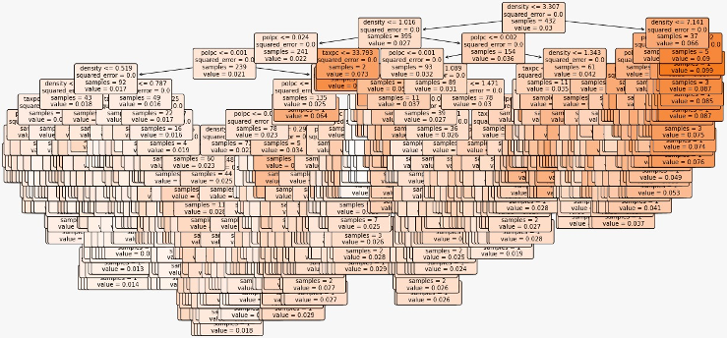
13) Decision Tree
A decision tree is a supervised machine learning algorithm used for both classification and regression tasks. In this case, it is applied for regression (DecisionTreeRegressor). The tree is constructed by recursively splitting the data based on the features to create decision nodes. Each leaf node represents a prediction for the target variable. Decision trees are interpretable and can capture complex relationships in the data. However, they may be prone to overfitting, and techniques like pruning or using ensemble methods (e.g., Random Forest) can be employed to improve performance. The decision tree visualization provides insights into how the algorithm makes decisions based on the provided features.

Slide 25
Output:
• The code outputs the Mean Squared Error (MSE) as a measure of the model's performance.
• Additionally, a plot of the decision tree is displayed. Each node in the tree represents a decision based on a feature, and the leaves represent the predicted values.
• To make a prediction, a new sample's features are tested against the tree. At each internal node, the decision rule is applied, and depending on the outcome, you move down the left or right branch of the tree until you reach a leaf node.
• The value at the leaf node gives the predicted outcome for the sample. In regression trees, this value is typically the mean of the dependent variable for the samples in the leaf.
• The decision tree in the image seems to be from a regression problem, given the continuous nature of the "value" at the leaf nodes.
• The tree has been fully grown or pruned to a certain depth, and we can see that it includes many splits on various features.
• The features used for splits, such as 'density', 'taxpc', 'polpc', etc., indicate the variables that the model found to be important in predicting the target variable.
• The MSE and values at the leaves indicate how well the tree fits the data at each terminal node and the expected outcome for the samples that reach each leaf.

Slide 26
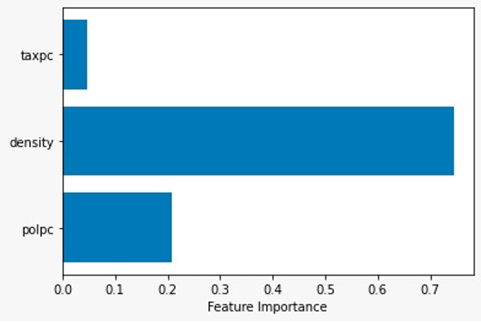
14) Gradient Boosting
Gradient Boosting is an ensemble learning method that combines the predictions of multiple weak learners (usually decision trees) to create a strong predictive model. It builds trees sequentially, with each tree correcting the errors of the previous ones. The model is trained in an additive manner, and shrinkage (learning rate) controls the contribution of each tree. Gradient Boosting is effective for regression and classification tasks and is less prone to overfitting compared to individual decision trees. Feature importance in Gradient Boosting reflects the contribution of each feature to the model's predictive

Slide 27
Output:
• The code outputs the Mean Squared Error (MSE) as a measure of the model's performance.
• Additionally, a horizontal bar plot is displayed, showing the feature importance values for 'polpc', 'density', and 'taxpc'.
Density:
• This feature has the highest importance score, which is around 0.7. It implies that 'density' is the most influential variable in the Gradient Boosting model for predicting the target variable.
Taxpc:
• The feature 'taxpc' has a lower score compared to 'density', around 0.2, making it the second most important feature in this model.
Polpc:
The 'polpc' feature has the lowest importance score among the three listed features, which suggests it has a smaller but still non-negligible effect on the model's predictions.
• The model has determined that 'density' is a key predictor, which might mean that the target variable is strongly related to the density of the area in question.
• The relative importance of 'taxpc' and 'polpc' suggests these features also affect the target but to a lesser extent than 'density' Knowing the importance of features can also guide feature engineering.
• One might consider creating new features that are combinations or transformations of 'density', 'taxpc', and 'polpc' to see if they can improve model performance.

Slide 28

Conclusion
In conclusion, our analysis and modeling efforts have provided valuable insights into the dataset. Each technique contributed to a deeper understanding of the data, and the selection of methods was driven by the specific goals of our project. It is crucial to note that the choice of algorithms and visualization tools depends on the nature of the data and the objectives of the analysis. The holistic approach taken in this project has equipped us with a comprehensive toolkit for future machine learning endeavors.
For access to the dataset, please use the following link:
http://fmwww.bc.edu/ec-p/data/wooldridge2k/CORNWELL.DES

Slide 29

Thank you!

